Slide 1
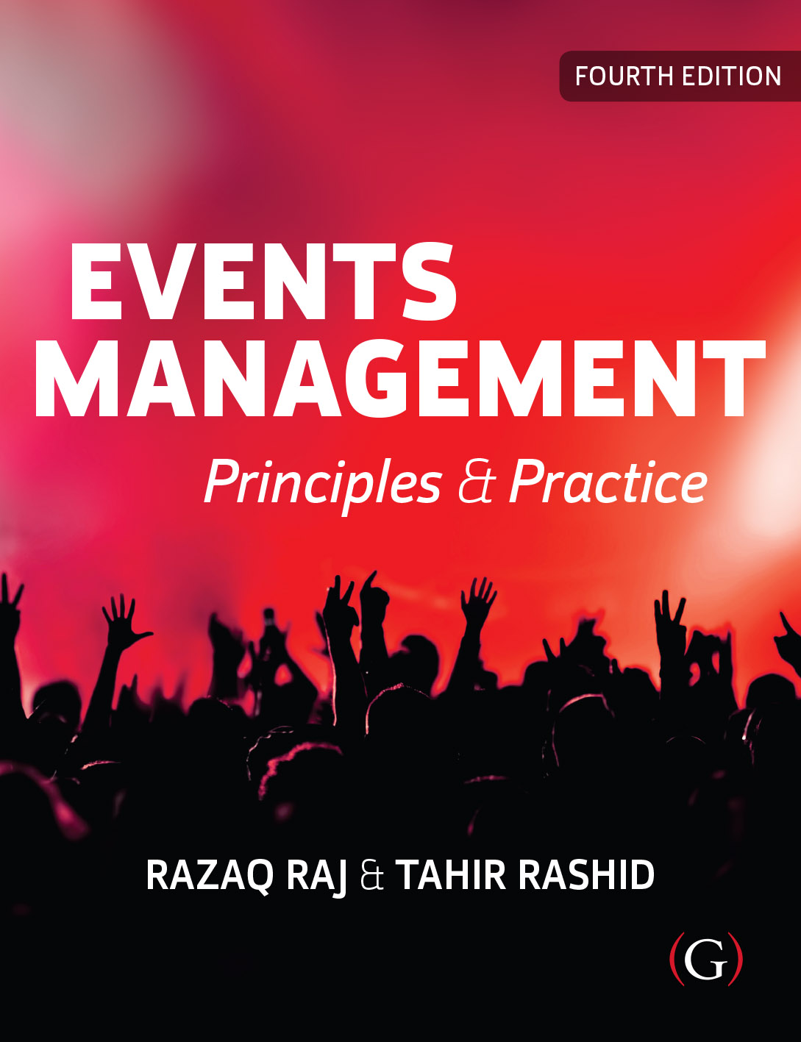
Events Management: Principles & Practice, 4th Edition
By Razaq Raj and Tahir Rashid

Slide 2
Chapter 10
Marketing Process, Communications And Public Relations
These are some bullet points:
The focus will be upon positioning an event favourably in the mind of its target market in order to ensure long-term success.
The chapter look at the marketing concepts and marketing research in relation to events.
The chapter will then examine the behaviour of consumers and how they can be segmented.
A detailed discussion follow on the marketing mix and its constituents: product, price, place and promotion, as applied to events.

Slide 3
Application of the Marketing Concept to Events
There have been numerous definitions of marketing and no single definition is correct. Below are just a few of the definitions which have been used.
  The process by which companies create value for customers and build strong customer relationships in order to capture value from customers in return. (Kotler and Armstrong, 2014: 27)
  Marketing is the achievement of corporate goals through meeting and exceeding customer needs better than the competition. (Jobber and Chadwick, 2019: 8)

Slide 4
Application of the Marketing Concept to Events
Marketing activities that an event manager should undertake to produce a successful event or festival:
Analyse the target market to establish appropriate event components, or products.
Establish what other competitive events could satisfy similar needs, in order to ensure their event has a unique selling proposition.
Predict how many people will attend the event.
Predict at what time people will come to the event.
Estimate what price they will be willing to pay to attend the event.
Decide on the type and quantity of promotional activities needed to inform and attract the target market to the event.
Decide how the tickets to the event can reach the target market.
Establish the degree of success for marketing events.

Slide 5
Crowd Management
Raj and Griffin (2018, p.19) further argues that event staff needs to be visible and accessible for attendees.
“For example, for mass gathering the festival organisers needs to put up barriers to reduce the flow of people wanting to enter the religious site. The staff needs to assure the security and prevent people from crushing into fixed structures and barriers”.
The event organiser should have event co-ordination team on site to make smooth running of event site and check that suppliers and contractors are using specific and tested sound and lighting.

Slide 6
Guidelines to Manage the Crowd
The owner of the venue where you are proposing to hold your event.
Transport operators and/or management of nearby transport hubs.
Management of adjoining or adjacent public venues.
Others providing services for the event (eg security, stewarding, first-aid and welfare organisations, safety officers, merchandising, construction and technical staff).
Local residents or their representatives, particularly if you are organising an event such as a carnival parade that goes through their residential area.
https://www.hse.gov.uk/event-safety/crowd-management-work-with-others.htm

Slide 7
Live Events Health and Safety Standards
Production management team responsible for health and safety standards are met according to following UK and European regulations.
  The Health Protection (Coronavirus, Restrictions) (England) (No. 3) Regulations 2020
  Control of Major Accident Hazards (COMAH) Regulations 2015
  Licensing Act 2003
  Management of Health and Safety at Work Regulations 1999
  Health and Safety at Work Act 1974 (HSWA)

Slide 8
Event Production Team and Safety Advisory Group (SAG)
The Health and Safety Executives (HSE) have recommended the event organiser should work with local authority Safety Advisory Group (SAG).
SAGs are set up by the local authority (LA) and made up of representatives from all emergency services, key stakeholders and event organiser.
The SAGs are based within each local authority boundaries.
SAGs help event organisers with the site production, health and safety, planning, security and cooperation and between appropriate agencies.

Slide 9
Birmingham local authority Safety Advisory Group (SAG). The SAG is chaired by the local authority.
  Local Authority
  West Midlands Police Service
  West Midlands Fire Service
  West Midlands Ambulance Service
  Event Organiser
  Licence Holder
  Security provider
  Medical provider
  Other stakeholders
  The SAG is chaired by the local authority

Slide 10
Erection of Temporary Demountable Structures
Department of Communities and Local Government and the Institutions of Structural and Civil Engineers (2017) has issued guideline for event industry to follow use of temporary demountable structures such as:
  Stage structures
  Marquees
  Grandstands for sport events
  Temporary Barriers
  Towers and Masts for Media facilities
  Lighting Towers

Slide 11
Temporary Demountable Structures
Temporary structure check list.
  Site Structure drawings
  Full calculations of temporary structure capacity
  Design loads of temporary structure
  Relevant test results being carried at site
  Risk assessments covering the design and erection
  Safety method declaration of site
  Completion certificate of temporary structure

Slide 12
Lighting and Sound System
The lighting and sound system is one of the key areas of the event and festival industry.
sound system is required need meet the safety and noise requirements.
HSE Control of Noise at Work Regulations 2005.
Rigorous methods in place to manage the sounds and lights systems

Slide 13
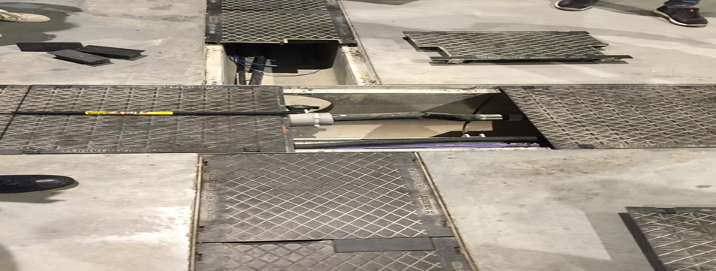
Wiring Lights and PA System at Yorkshire Event Centre

Slide 14
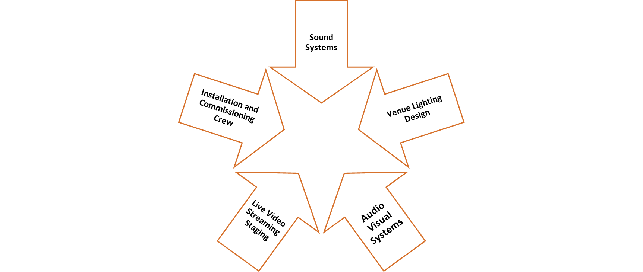
Live Event Sound and Lights Phases

Slide 15
Summary
The responsibility of the production team to verify that all staging, lighting, sound system, videos screens, wireless communication, power distribution and all other key technical equipment able to deliver to high quality to enhance the experience of event attendees.
It is important contractors and suppliers should have safety records of lighting that are being provided for the event and it is responsibility of the event organisers to check, if the lightings that are being installed conform to regulations.
All electrical equipment brought to onsite by the contractors should be meet the safety stand-ards and are in good condition.

